Slide 1
Module 2: Supplementary Slides

Slide 2
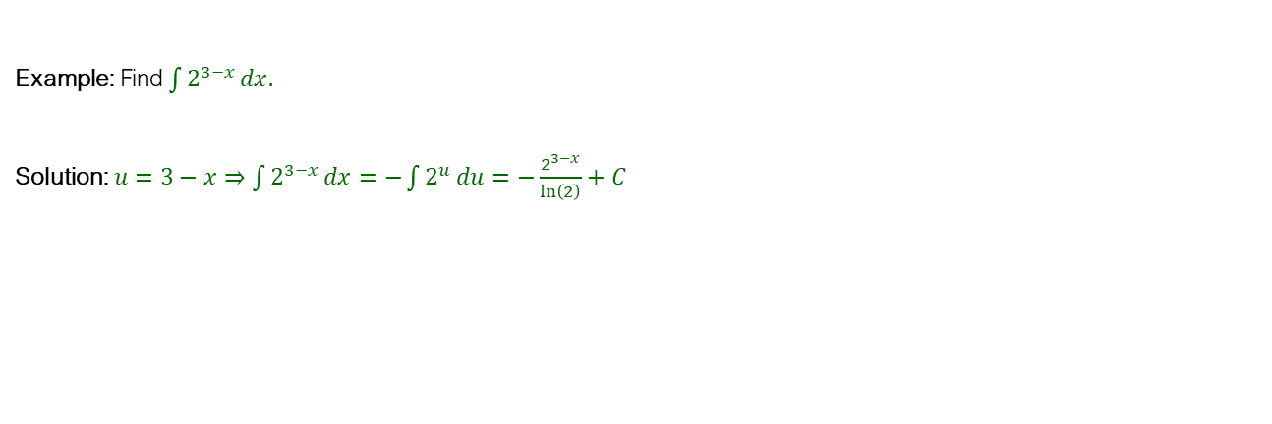

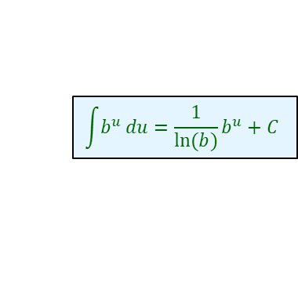
Using Substitution
An Integral Involving $b^{u}$
$$\int{b^{u}}du=\frac{1}{\ln{(b)}}b^{u}+C$$
$$y=b^{u}=e^{ln(b^{u})}=e^{uln(b)}⇒y′=ln\left(b\right)e^{uln\left(b\right)}=b^{u}ln(b)$$
Example: Find $\int{2^{3−x}}dx.$
Solution: $u=3−x⇒\int{2^{3−x}}dx=−\int{2^{u}}du=−\frac{2^{3−x}}{\ln\left(2\right)}+C$

Slide 3
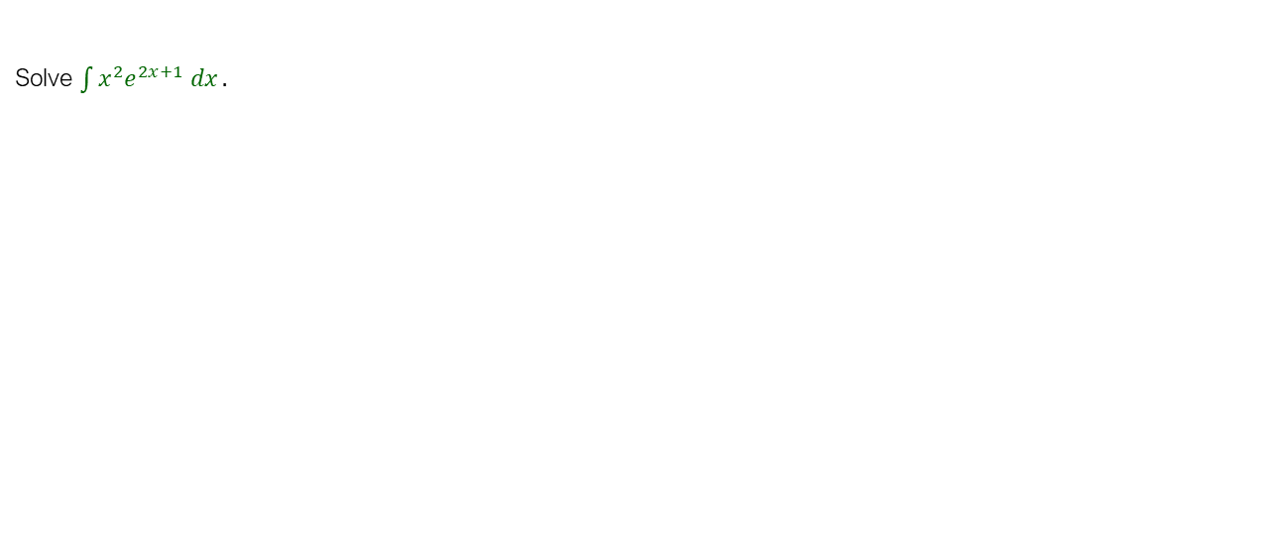
Example
Repeated Integration by Parts
Solve $\int{x^{2}e^{2x+1} dx}.$

Slide 4
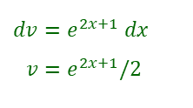
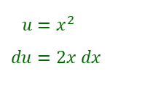
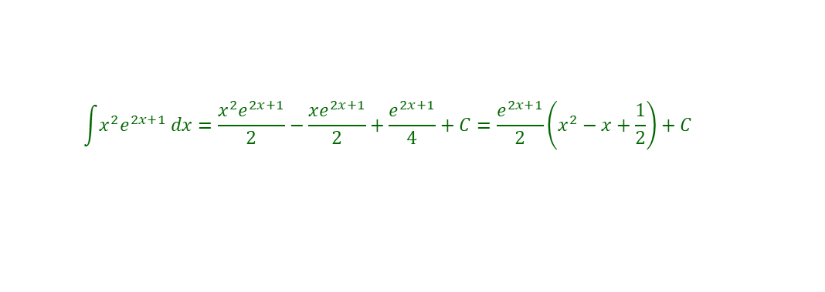
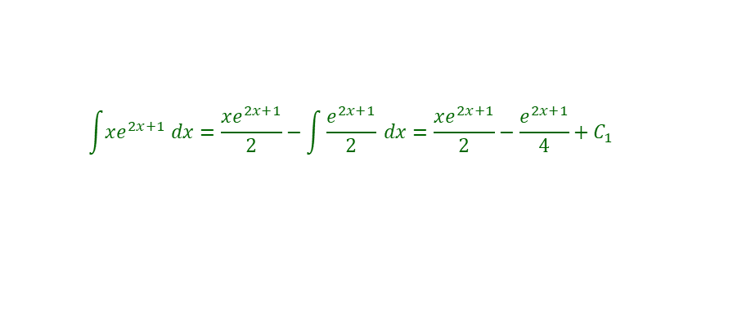
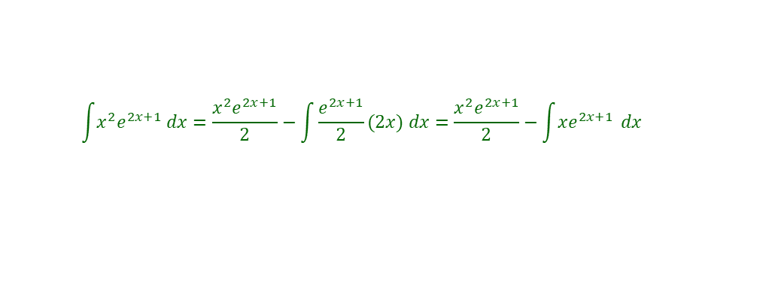
Solution
$$u=x^{2} \\ du=2x dx$$
$$dv=e^{2x+1} dx \\ v=e^{2x+1}/2$$
$$\int{x^{2}e^{2x+1} dx}=\frac{x^{2}e^{2x+1}}{2}−\int{\frac{e^{2x+1}}{2}}(2x) dx=\frac{x^{2}e^{2x+1}}{2}−\int{xe^{2x+1}} dx$$
$$\int{xe^{2x+1} dx}=\frac{xe^{2x+1}}{2}−\int{\frac{e^{2x+1}}{2}} dx=\frac{xe^{2x+1}}{2}−\frac{e^{2x+1}}{4}+C_{1}$$
$$\int{x^{2}e^{2x+1} dx}=\frac{x^{2}e^{2x+1}}{2}−\frac{xe^{2x+1}}{2}+\frac{e^{2x+1}}{4}+C=\frac{e^{2x+1}}{2}\left(x^{2}−x+\frac{1}{2}\right)+C$$

Slide 5
Creating Loops in R
Creating Loops
for (variable in vector) {
expressions
}
while (condition) {
}
g=function(n){
s=1;
if(n<0) s="give a positive value!“;
if (n==0) {s=1};
if (n>=1){
for (i in 1:n){s=s*i}
}
return(s);
}
s=1
while(s<=5){s=s+1;print(s);}

Slide 6
Recursive or Nested Functions
Creating Recursive Functions
f=function (n){
f(n-1) can be called within the function
}
f=function(n){
if (n==0) {y=1};
if (n>0){y=n*f(n-1)};
if(n<0) {y="Give a positive number!"};
return (y);}
f=function(n){
if (n==1) {y=1};
if (n>0){y=n^2+f(n-1)};
if(n<0) {y="Give a positive number!"};
return (y);}

Slide 7
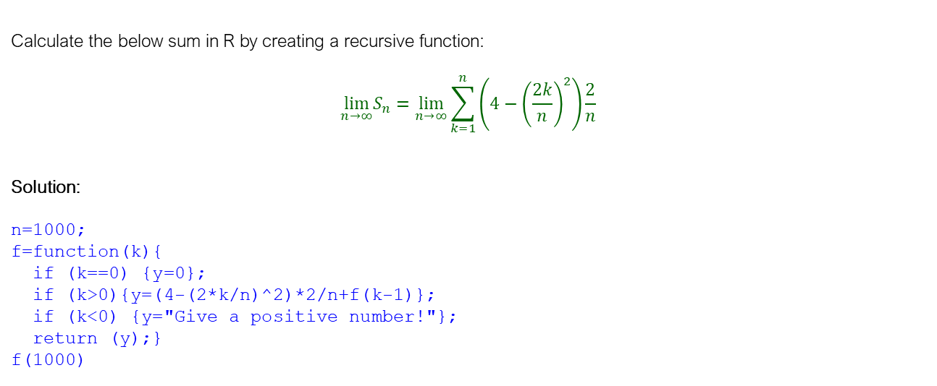
Example
Creating Recursive Functions
Calculate the below sum in R by creating a recursive function:
$${\lim_{n→∞}S}_{n}=\lim_{n→∞}\sum_{k=1}^{n}{\left(4−{\left(\frac{2k}{n}\right)}^{2}\right)}\frac{2}{n}$$
Solution:
n=1000;
f=function(k){
if (k==0) {y=0};
if (k>0){y=(4-(2*k/n)^2)*2/n+f(k-1)};
if (k<0) {y="Give a positive number!"};
return (y);}
f(1000)

Slide 8
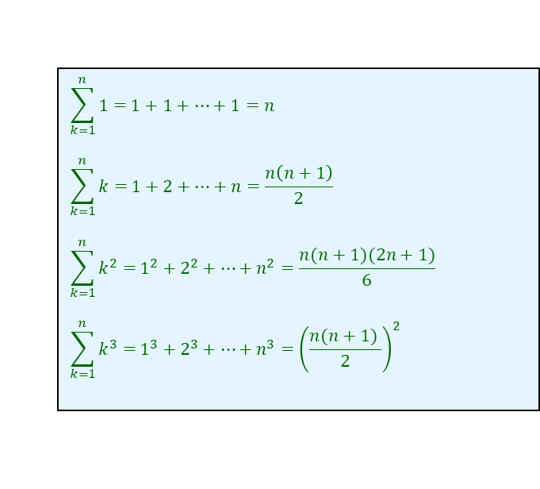
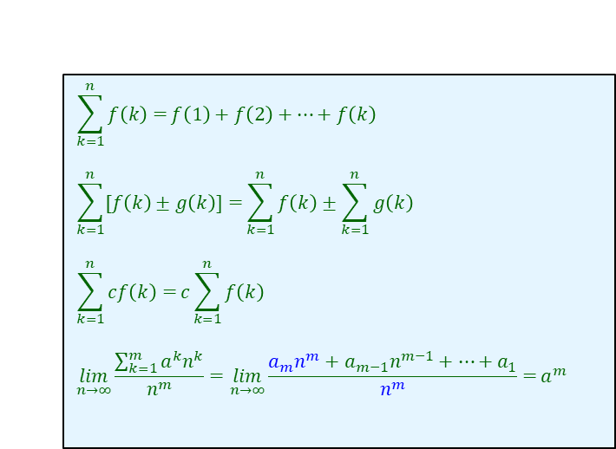
The Definite Integral
Some Important Summations
$$\sum_{k=1}^{n}{f\left(k\right)=}f\left(1\right)+f\left(2\right)+…+f\left(k\right)$$
$$\sum_{k=1}^{n}{[f\left(k\right)±g\left(k\right)]=}\sum_{k=1}^{n}{f\left(k\right)}±\sum_{k=1}^{n}{g\left(k\right)}$$
$$\sum_{k=1}^{n}{cf\left(k\right)=}c\sum_{k=1}^{n}{f\left(k\right)}$$
$$\lim_{n→∞}{\frac{\sum_{k=1}^{m}{a^{k}n^{k}}}{n^{m}}={\lim_{n→∞}{\frac{a_{m}n^{m}+a_{m−1}n^{m−1}+…+a_{1}}{n^{m}}=}a}^{m}}$$
$$\sum_{k=1}^{n}{1=}1+1+…+1=n$$
$$\sum_{k=1}^{n}{k=}1+2+…+n=\frac{n\left(n+1\right)}{2}$$
$$\sum_{k=1}^{n}{k^{2}=}1^{2}+2^{2}+…+n^{2}=\frac{n(n+1)(2n+1)}{6}$$
$$\sum_{k=1}^{n}{k^{3}=}1^{3}+2^{3}+…+n^{3}={\left(\frac{n(n+1) }{2}\right)}^{2}$$

Slide 9
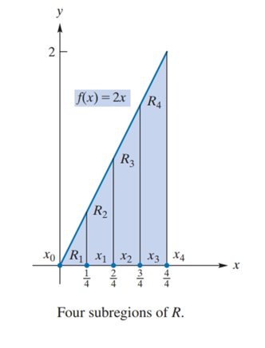
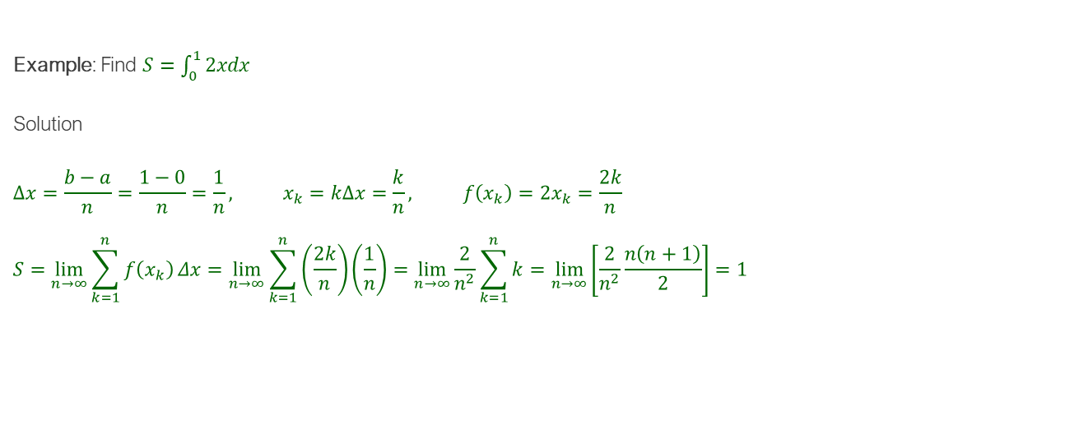
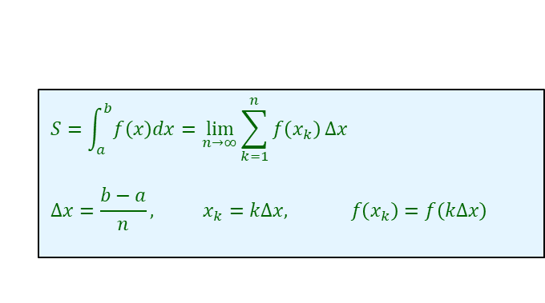
The Definite Integral
Recap: Definite Integral as a Limit of a Sum
$$S=\int_{a}^{b}{f\left(x\right)dx}=\lim_{n→∞}{\sum_{k=1}^{n}{f\left(x_{k}\right)}Δx}$$
$$Δx=\frac{b−a}{n}, x_{k}=kΔx, f\left(x_{k}\right)=f\left(kΔx\right)$$
Example: Find $S=\int_{0}^{1}{2xdx}$
Solution
$$Δx=\frac{b−a}{n}=\frac{1−0}{n}=\frac{1}{n}, x_{k}=kΔx=\frac{k}{n}, f\left(x_{k}\right)=2x_{k}=\frac{2k}{n}$$
$$S=\lim_{n→∞}{\sum_{k=1}^{n}{f\left(x_{k}\right)}Δx}=\lim_{n→∞}\sum_{k=1}^{n}{\left(\frac{2k}{n}\right)}\left(\frac{1}{n}\right)=\lim_{n→∞}\frac{2}{n^{2}}\sum_{k=1}^{n}{k}=\lim_{n→∞}\left[\frac{2}{n^{2}}\frac{n\left(n+1\right)}{2}\right]=1$$

Slide 10
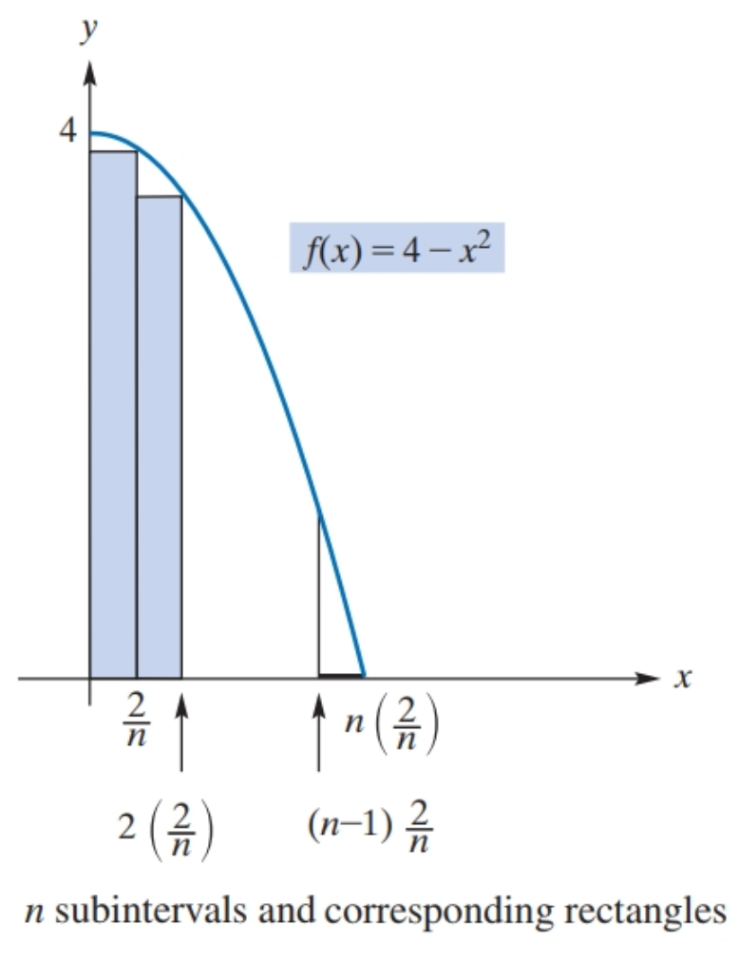

Example
Definite Integral as a Limit of a Sum
Find the area of the region bounded by $f\left(x\right)=4−x^{2}$ between $x=0$ and $x=2$.

Slide 11
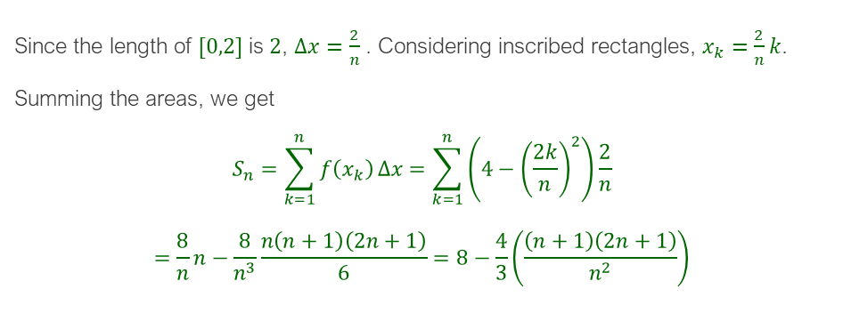
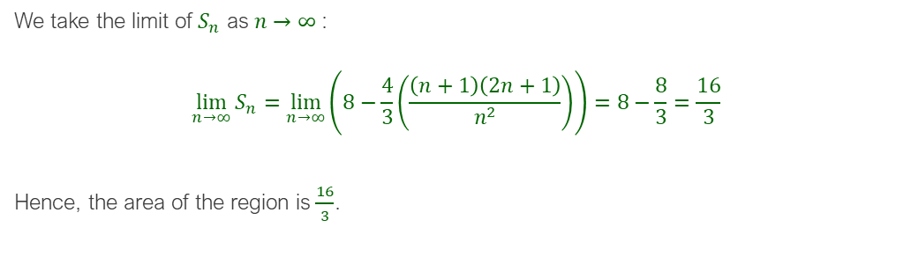
Solution
Since the length of $[0,2]$ is $2$, $Δx=\frac{2}{n}$ . Considering inscribed rectangles, $x_{k}=\frac{2}{n}k$. Summing the areas, we get
$$S_{n}=\sum_{k=1}^{n}{f\left(x_{k}\right)}Δx=\sum_{k=1}^{n}{\left(4−{\left(\frac{2k}{n}\right)}^{2}\right)}\frac{2}{n}$$
$$=\frac{8}{n}n−\frac{8}{n^{3}}\frac{n\left(n+1\right)\left(2n+1\right)}{6}=8−\frac{4}{3}\left(\frac{\left(n+1\right)\left(2n+1\right)}{n^{2}}\right)$$
We take the limit of $S_{n}$ as $n→∞$:
$$\lim_{n→∞}{S_{n}}=\lim_{n→∞}\left(8−\frac{4}{3}\left(\frac{\left(n+1\right)\left(2n+1\right)}{n^{2}}\right)\right)=8−\frac{8}{3}=\frac{16}{3}$$
Hence, the area of the region is $\frac{16}{3}$.

Slide 12
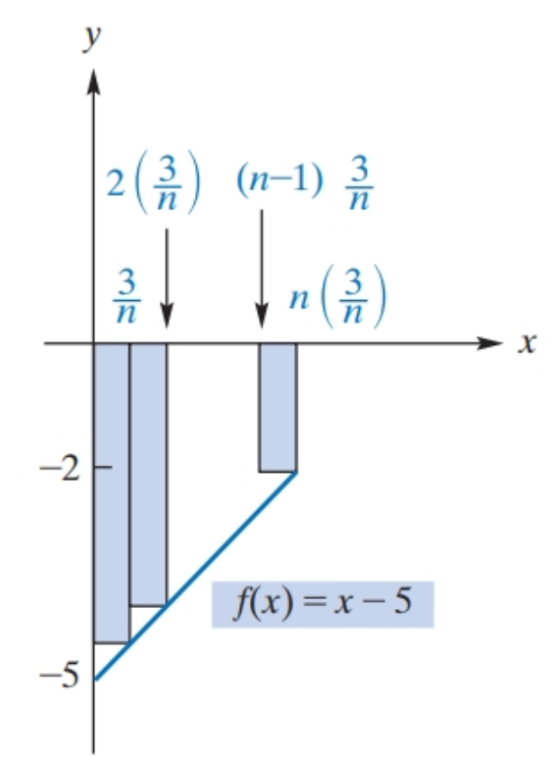

Example
Definite Integral as a Limit of a Sum
Integrate $f\left(x\right)=x−5$from $x=0$to $x=3$

Slide 13
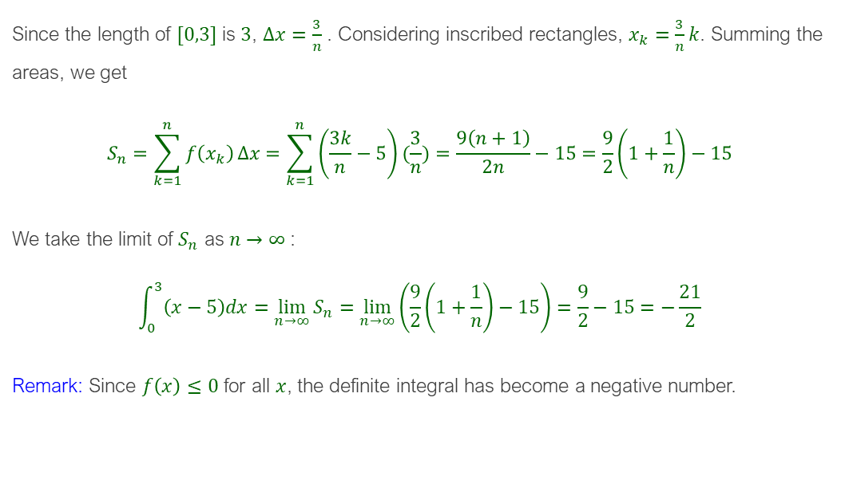
Solution
Since the length of $[0,3]$ is $3$, $Δx=\frac{3}{n}$ . Considering inscribed rectangles, $x_{k}=\frac{3}{n}k$. Summing the areas, we get
$$S_{n}=\sum_{k=1}^{n}{f\left(x_{k}\right)}Δx=\sum_{k=1}^{n}{\left(\frac{3k}{n}−5\right)}(\frac{3}{n})=\frac{9\left(n+1\right)}{2n}−15=\frac{9}{2}\left(1+\frac{1}{n}\right)−15$$
We take the limit of $S_{n}$ as $n→∞$:
$$\int_{0}^{3}{\left(x−5\right)dx}=\lim_{n→∞}{S_{n}}=\lim_{n→∞}\left(\frac{9}{2}\left(1+\frac{1}{n}\right)−15\right)=\frac{9}{2}−15=−\frac{21}{2}$$
Remark: Since $f\left(x\right)≤0$ for all $x$, the definite integral has become a negative number.

Slide 14
The Fundamental Theorem of Integral Calculus: Proof

Slide 15
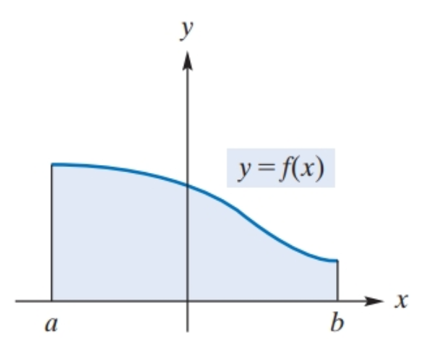
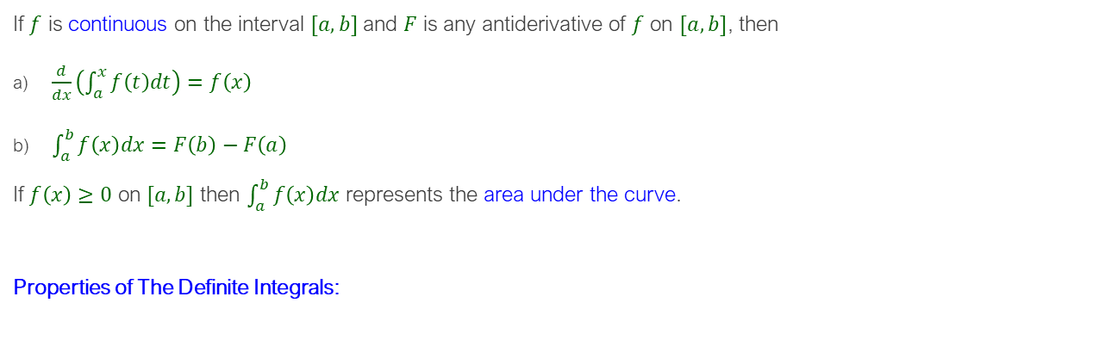
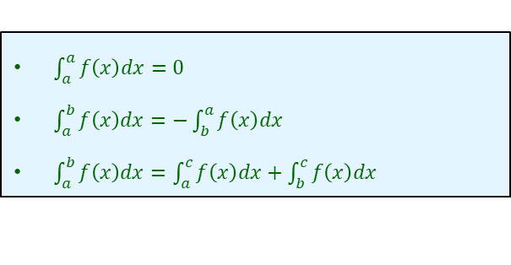
The Fundamental Theorem of Integral Calculus
Fundamental Theorem of Integral Calculus
If $f$ is continuous on the interval $[a,b]$and $F$ is any antiderivative of $f$ on $[a,b]$, then
$\frac{d}{dx}\left(\int_{a}^{x}{f\left(t\right)dt}\right)=f\left(x\right)$
$\int_{a}^{b}{f\left(x\right)dx}=F\left(b\right)−F\left(a\right)$
If $f\left(x\right)≥0$ on $[a,b]$ then $\int_{a}^{b}{f\left(x\right)dx}$ represents the area under the curve.
Properties of The Definite Integrals:
$\int_{a}^{a}{f\left(x\right)dx}=0$
$\int_{a}^{b}{f\left(x\right)dx}=−\int_{b}^{a}{f\left(x\right)dx}$
$\int_{a}^{b}{f\left(x\right)dx}=\int_{a}^{c}{f\left(x\right)dx}+\int_{b}^{c}{f\left(x\right)dx}$

Slide 16
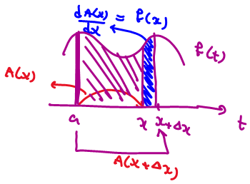

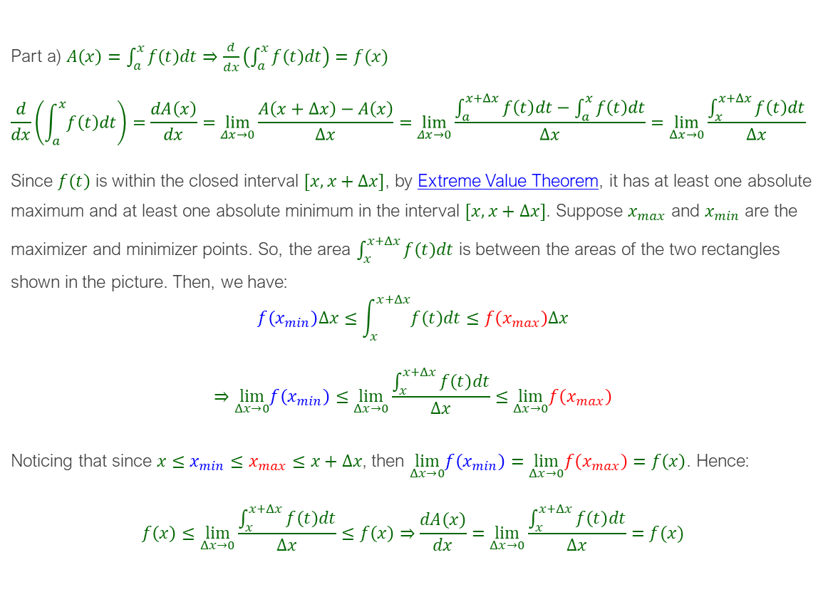
Part a) $A\left(x\right)=\int_{a}^{x}{f\left(t\right)dt}⇒\frac{d}{dx}\left(\int_{a}^{x}{f\left(t\right)dt}\right)=f(x)$
$$\frac{d}{dx}\left(\int_{a}^{x}{f\left(t\right)dt}\right)=\frac{dA\left(x\right)}{dx}=\lim_{Δx→0}{\frac{A\left(x+Δx\right)−A\left(x\right)}{Δx}}=\lim_{Δx→0}{\frac{\int_{a}^{x+Δx}{f\left(t\right)dt}−\int_{a}^{x}{f\left(t\right)dt}}{Δx}}=\lim_{Δx→0}{\frac{\int_{x}^{x+Δx}{f\left(t\right)dt}}{Δx}}$$
Since $f\left(t\right)$ is within the closed interval $[x,x+Δx]$, by Extreme Value Theorem, it has at least one absolute maximum and at least one absolute minimum in the interval $[x,x+Δx]$. Suppose $x_{max}$ and $x_{min}$ are the maximizer and minimizer points. So, the area $\int_{x}^{x+Δx}{f\left(t\right)dt}$ is between the areas of the two rectangles shown in the picture. Then, we have:
$$f\left(x_{min}\right)Δx≤\int_{x}^{x+Δx}{f\left(t\right)dt}≤f\left(x_{max}\right)Δx$$
$$⇒\lim_{Δx→0}f\left(x_{min}\right)≤\lim_{Δx→0}\frac{\int_{x}^{x+Δx}{f\left(t\right)dt}}{Δx}≤\lim_{Δx→0}f\left(x_{max}\right)$$
Noticing that since $x≤x_{min}$ $≤x_{max}$ $≤x+Δx$, then $\lim_{Δx→0}f\left(x_{min}\right)=\lim_{Δx→0}f\left(x_{max}\right)=f\left(x\right)$. Hence:
$$f\left(x\right)≤\lim_{Δx→0}\frac{\int_{x}^{x+Δx}{f\left(t\right)dt}}{Δx}≤f\left(x\right)⇒\frac{dA\left(x\right)}{dx}=\lim_{Δx→0}\frac{\int_{x}^{x+Δx}{f\left(t\right)dt}}{Δx}=f(x)$$

Slide 17
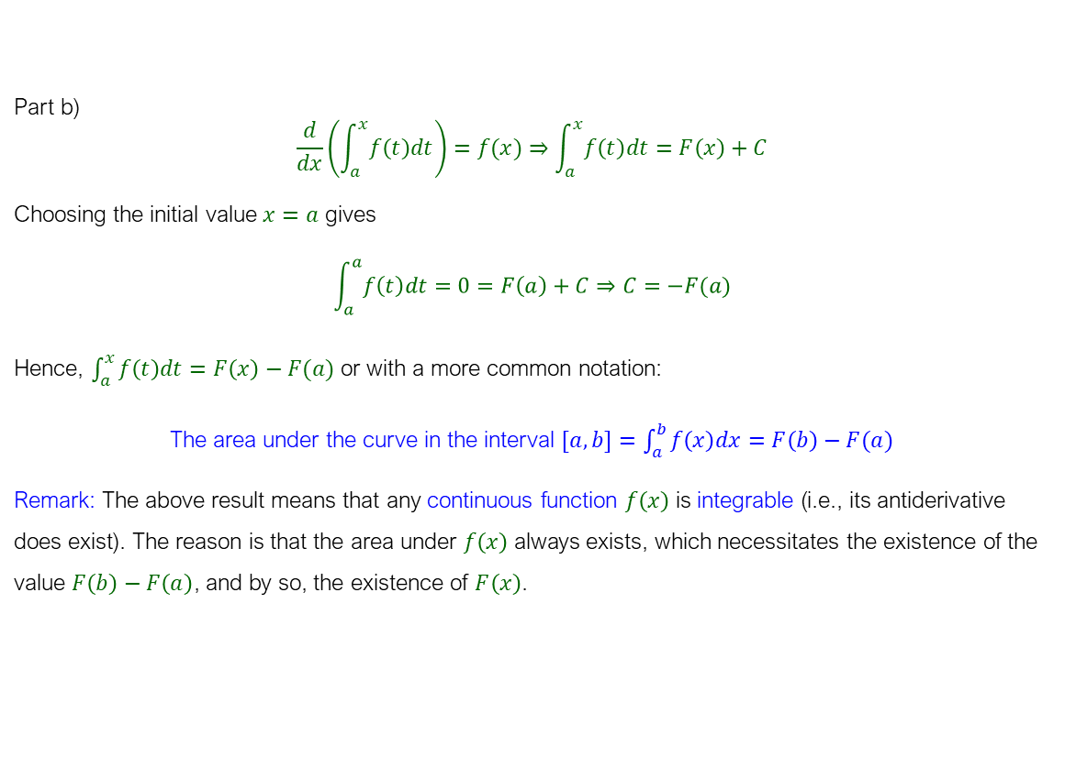
Part b)
$$\frac{d}{dx}\left(\int_{a}^{x}{f\left(t\right)dt}\right)=f(x)⇒\int_{a}^{x}{f\left(t\right)dt}=F\left(x\right)+C$$
Choosing the initial value $x=a$ gives
$$\int_{a}^{a}{f\left(t\right)dt}=0=F\left(a\right)+C⇒C=−F(a)$$
Hence, $\int_{a}^{x}{f\left(t\right)dt}=F\left(x\right)−F(a)$ or with a more common notation:
The area under the curve in the interval $[a,b]=\int_{a}^{b}{f\left(x\right)dx}=F\left(b\right)−F(a)$
Remark: The above result means that any continuous function $f\left(x\right)$ is integrable (i.e., its antiderivative does exist). The reason is that the area under $f\left(x\right)$ always exists, which necessitates the existence of the value $F\left(b\right)−F\left(a\right)$, and by so, the existence of $F\left(x\right)$.

Slide 18
Leibniz Integral Rule

Slide 19
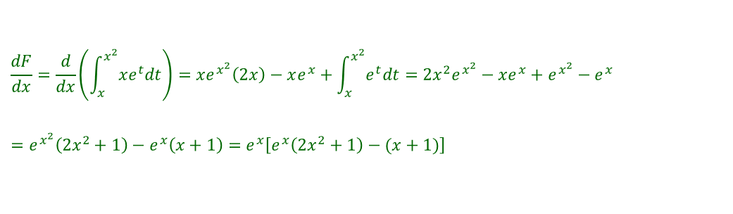
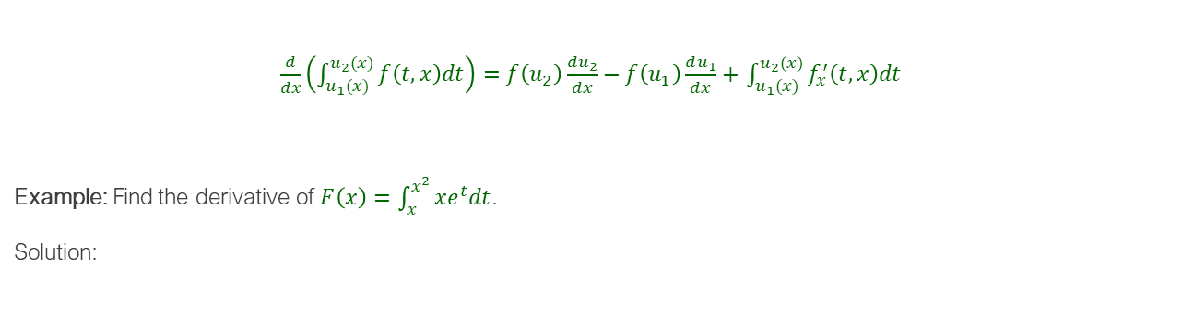
Leibniz Integral Rule
$\frac{d}{dx}\left(\int_{u_{1}(x)}^{u_{2}(x)}{f\left(t,x\right)dt}\right)=f\left(u_{2}\right)\frac{du_{2}}{dx}−f\left(u_{1}\right)\frac{du_{1}}{dx}+$ $\int_{u_{1}(x)}^{u_{2}(x)}{f_{x}^{′}\left(t,x\right)dt}$
Example: Find the derivative of $F\left(x\right)=\int_{x}^{x^{2}}{xe^{t}dt}$.
Solution:
$$\frac{dF}{dx}=\frac{d}{dx}\left(\int_{x}^{x^{2}}{xe^{t}dt}\right)=xe^{x^{2}}\left(2x\right)−xe^{x}+\int_{x}^{x^{2}}{e^{t}dt}=2x^{2}e^{x^{2}}−xe^{x}+e^{x^{2}}−e^{x}=e^{x^{2}}\left(2x^{2}+1\right)−e^{x}\left(x+1\right)=e^{x}\left[e^{x}\left(2x^{2}+1\right)−(x+1)\right]$$

Slide 20
Average Value of a Function

Slide 21





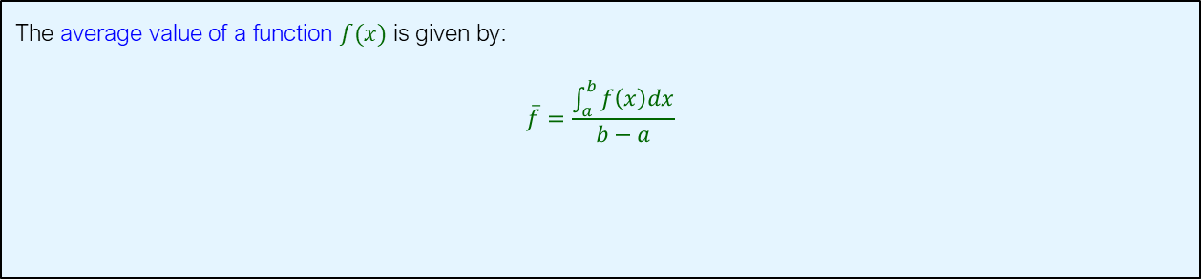

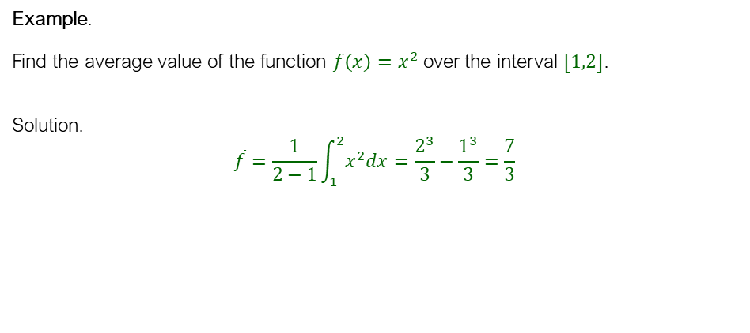




Average Value of a Function
The average value of a function $f(x)$ is given by:
$$\overline{f}=\frac{\int_{a}^{b}{f\left(x\right)dx}}{b−a}$$
Example.
Find the average value of the function $f\left(x\right)=x^{2}$ over the interval $[1,2]$.
Solution.
$$\overline{f}=\frac{1}{2−1}\int_{1}^{2}{x^{2}dx}=\frac{2^{3}}{3}−\frac{1^{3}}{3}=\frac{7}{3}$$

